Slide 1
Crafting a Solid “Plan for Improvement” & “Corrective Action Plan”

Slide 2
Performance vs Behavior
Plan for Improvement
  Performance or Evaluation-based
  JPAS addendum
  Career Educators and/or Provisional
Corrective Action Plan
  Behavior-based
  Employee discipline/misconduct
  All employees

Slide 3
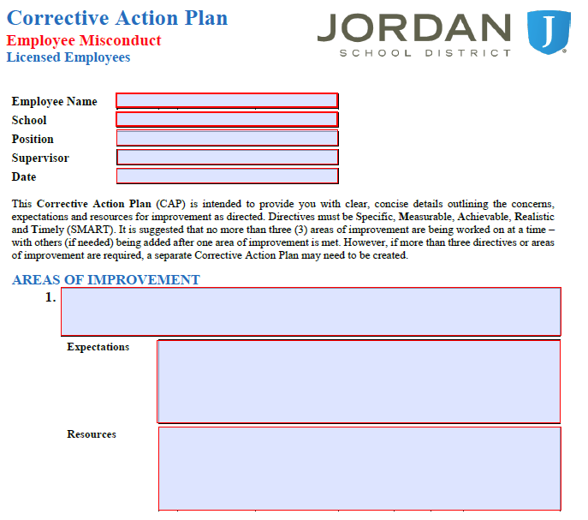
Plan For Improvement
A Plan for Improvement is REQUIRED for any Career Educator that scores in the “Not Effective” range on the JPAS (53A-8a-501 & 53A-8a-503)
JPAS Addendum is now the “Plan for Improvement”

Slide 4
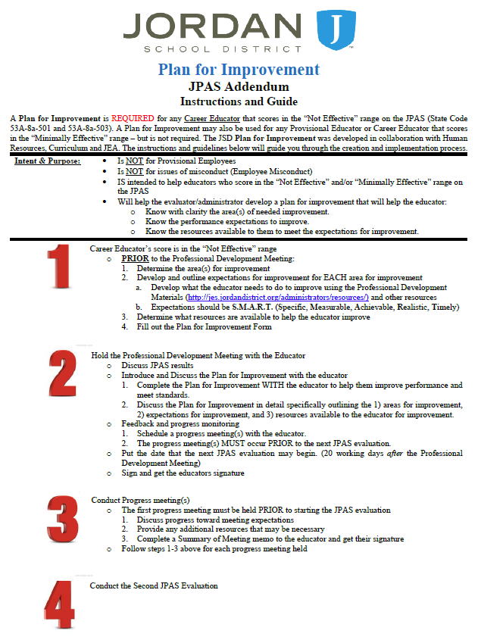
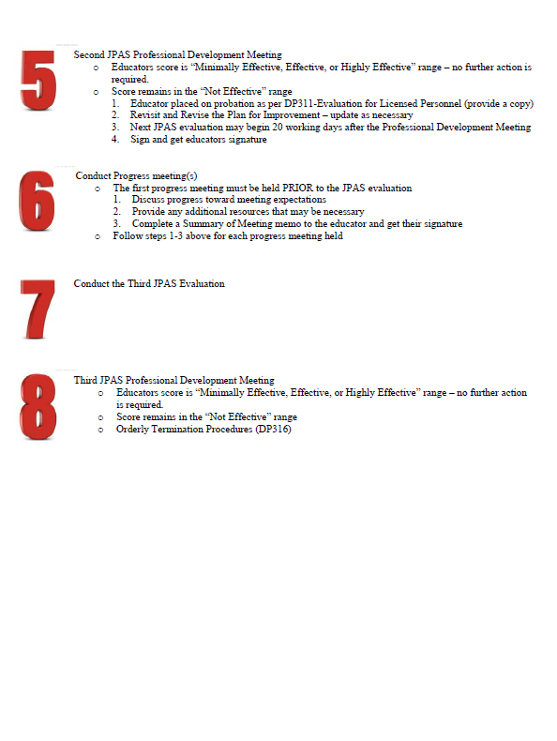
Plan For Improvement cont…
AdminOnly
JES www
8 steps for the educator who scores in the “Not Effective” range.

Slide 5
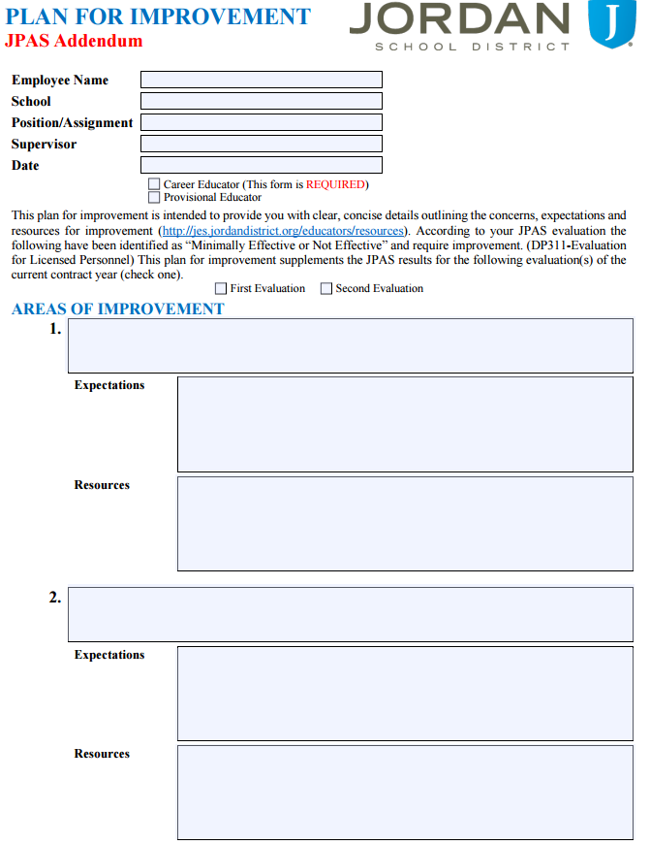
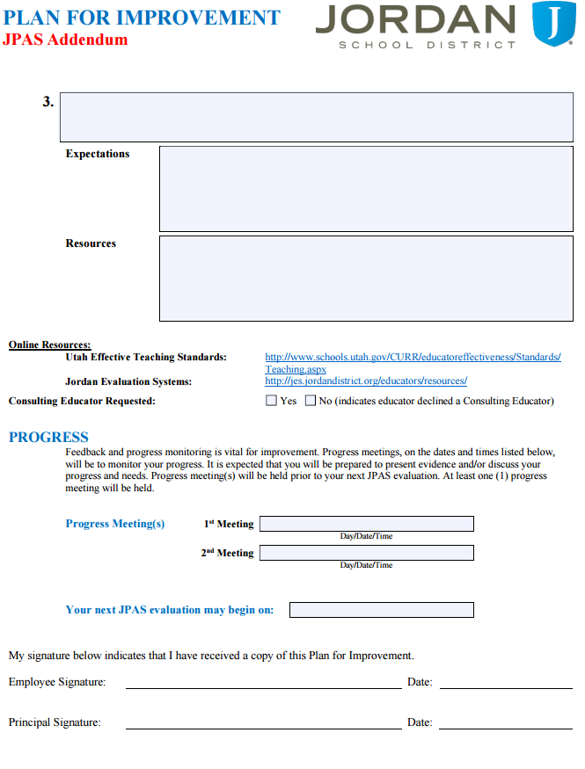
Plan For Improvement cont…
AdminOnly
JES www
Fillable pdf
Not less than one (1) but no more than three (3) areas of improvement
Must be filled out completely
Progress meeting is essential
This is the NEW JPAS Addendum

Slide 6
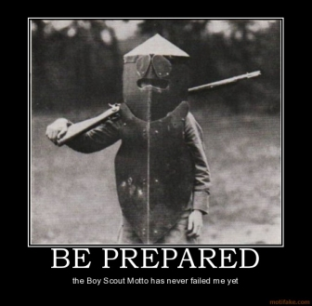
Plan For Improvement cont…
6 P’s
  Proper Prior Preparation Prevents Poor Performance

Slide 7
Plan For Improvement cont…
It is critical that you prepare the Plan for Improvement BEFORE the JPAS Professional Development Meeting
As the evaluator – we must be able to identify the areas of deficiency with enough knowledge to:
  Identify the needed area of improvement
  Provide expectations (behavior by the educator) for improvement
  Provide resources to the educator to help them improve. (this is not just attending a conference, etc.)
Set up at least one (1) progress meeting BEFORE the second JPAS
Schedule the second JPAS “start” date.
Secure signatures

Slide 8
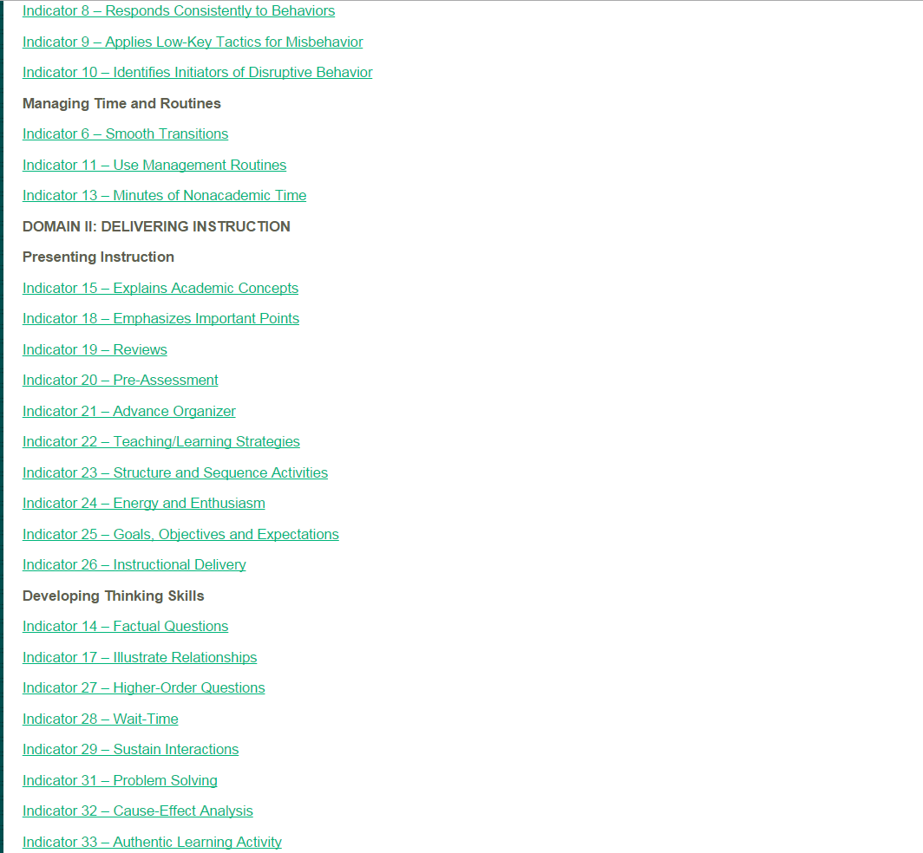
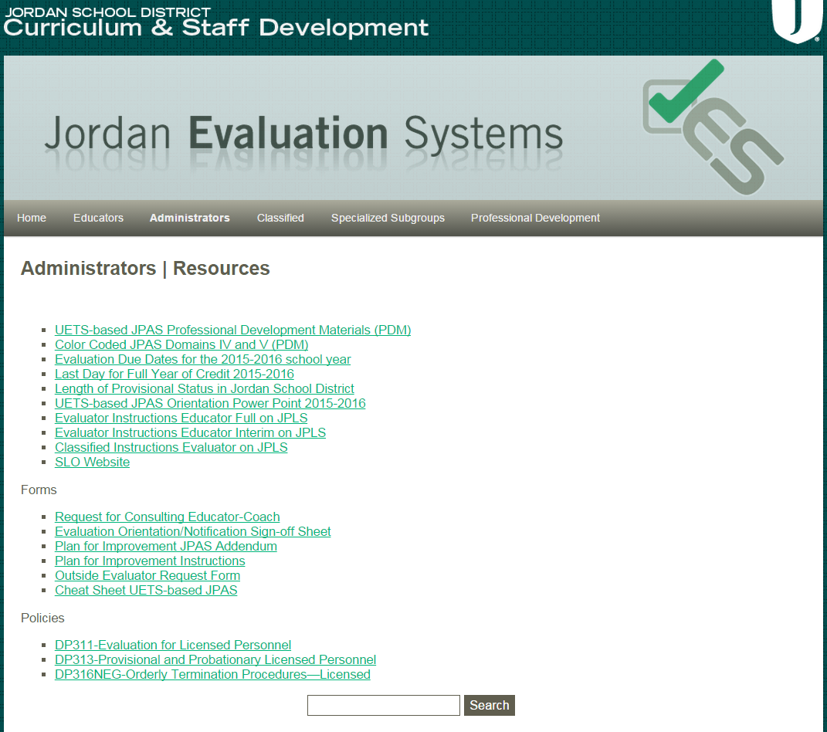
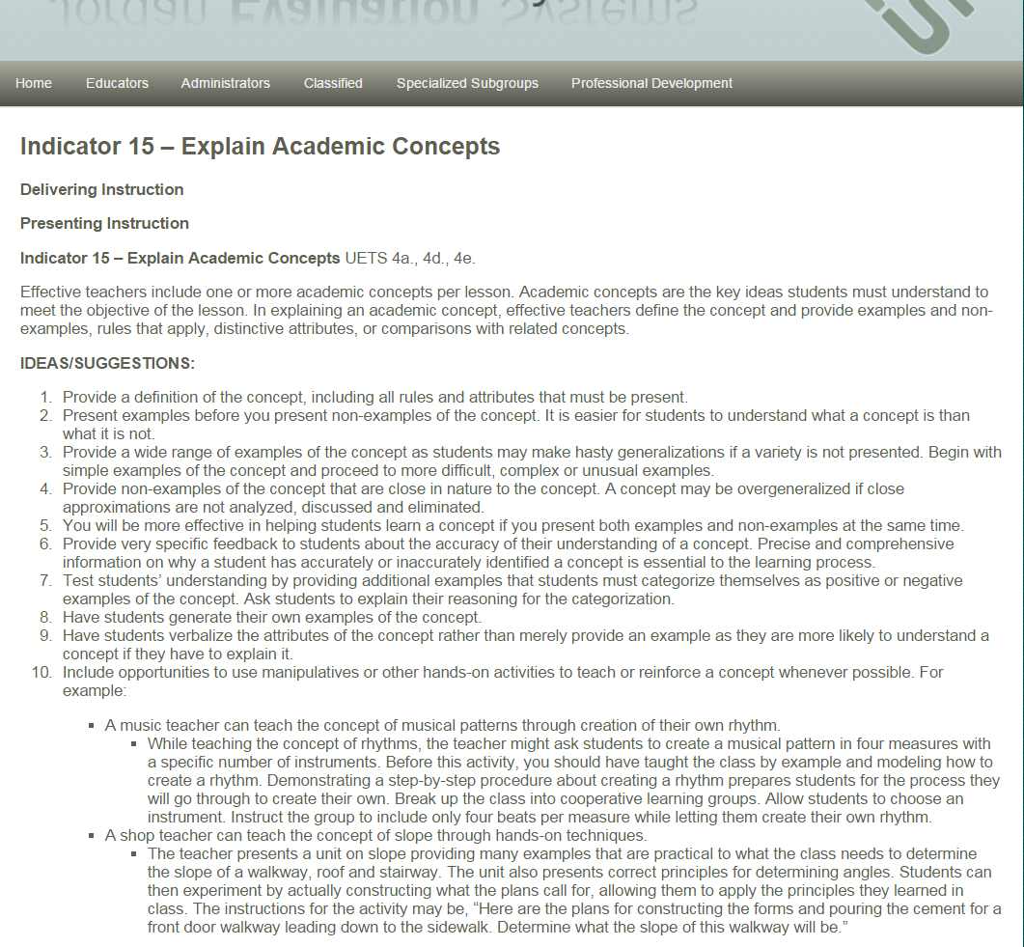
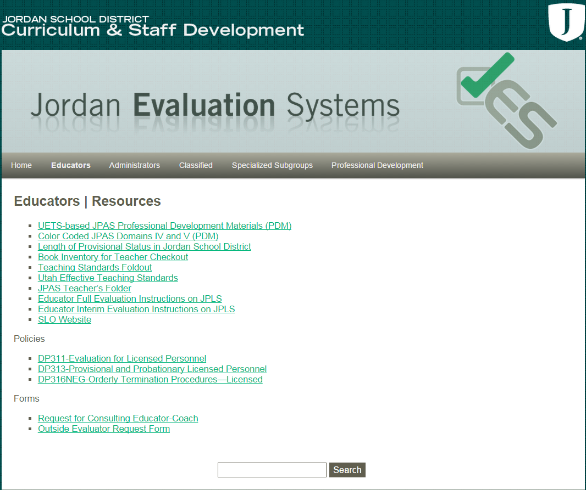
Plan for Improvement cont…
Resources on the JES www
Professional Development Materials includes ideas and suggestions you can use to help educators improve performance
The “Educators Resources” page provides assistance as well

Slide 9
SMART Goals:
S.M.A.R.T. Goals should be used when writing the “Expectations” portion of the Plan for Improvement.
  Specific
  Measurable
  Attainable
  Realistic
  Timely
Using SMART goals will allow you and employee to know exactly what is expected, when to expect it completed, and if it was completed. NO GUESSING.

Slide 10

Plan For Improvement cont…
Scenarios (5 min)
  At your tables
  Identify
    Areas of needed improvement
    What are the areas of greatest need (no more than 3)
    What can the educator do to improve effectiveness in the areas of greatest need?
    What resources and/or help can you provide to assist with the process of improvement
  Share out with the group

Slide 11
Plan For Improvement - Summary
PRIOR to PDM meeting develop/outline needs and expectations
PDM w/ educator – Discuss results, areas of needed improvement, complete the Plan for Improvement
Conduct the Progress meeting prior to the second JPAS
Conduct the JPAS evaluation
Scores Not Effective – repeat step 1
PDM #2
JPAS #3
PDM #3 (DP316 NEG)
Prior to PDM
PDM
Progress Meeting
PDM #2
JPAS Evaluation
Repeat Step 1
JPAS #3
PDM #3

Slide 12
Plan For Improvement cont…
We want ALL educators to improve.
Not just for Career Educators
Not just for “Not Effective”
In Summary:
  Must be completed (required) for Career teachers who are “Not Effective”
  Optional for all others
  A process to document & formalize improvement

Slide 13

JPAS Trainings
Through January, there are two (2) JPAS trainings a month for educators.
These are Level Specific (Elementary or Secondary)
Teachers sign up for the class in JPLS and may see all the dates/times on the JES www (Educators/Trainings)

Slide 14
Corrective Discipline Procedures
MISCONDUCT

Slide 15
Corrective Discipline
Like with students – we want to ensure we are progressing to the next lowest possible consequence.
The GOAL? – Improved behavior and/or compliance
This process is for employee misconduct that is NOT immediately threatening, violent, or endangers the immediate safety of the employee and/or others.
This process is NOT for performance related to JPAS.
This is not to be construed as being the process for ALL corrective discipline issues/situations. These are GENERAL GUIDELINES

Slide 16



Corrective Discipline

Slide 17
Corrective Discipline cont…
Always
  Contact your immediate supervisor
  Follow District Policy
  Involve others
  Act in the best interest of Students
  Remove yourself emotionally
  Make cognitive decisions NOT based on emotion
  Follow through
  Get signatures
Avoid
  Emotional responses
  Acting in isolation
  Ignoring misconduct
  Accepting responsibility for the employees misconduct
  Statements that corner you or that cannot be supported
  Blame game
  Allowing the employee to “Shift the Monkey”

Slide 18
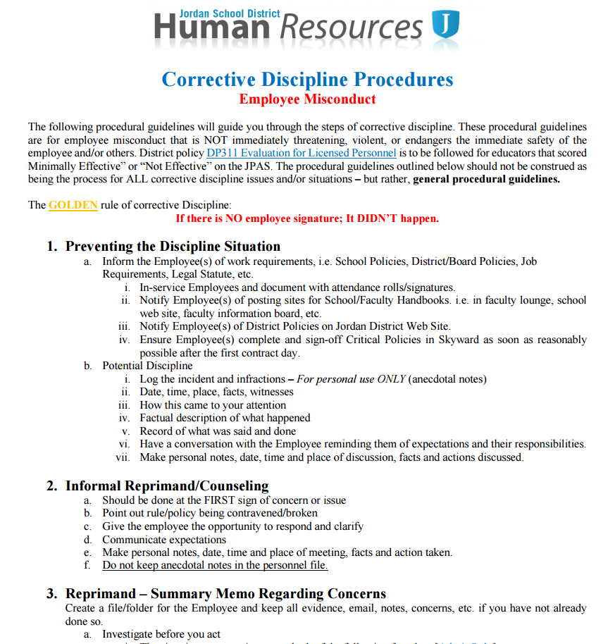
Employee Misconduct cont…
Corrective Discipline Procedures
  The LONG version
  General Procedural Guidelines
    Walks you through the entire process from beginning to end
    Intent is the help answer “what is the next step?”

Slide 19
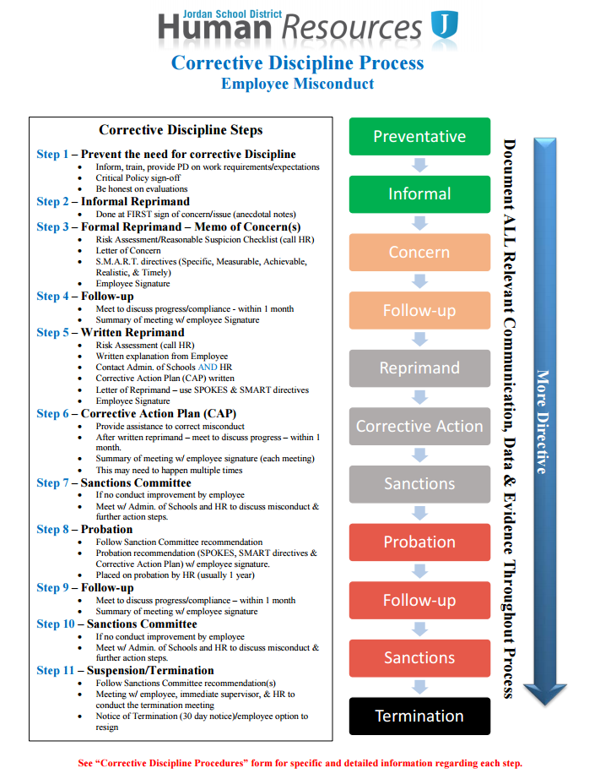
Employee Misconduct cont…
Corrective Discipline Process
The steps of corrective discipline summarized
Allows you to see the entire process at a glance
It is important to note that:
  Not ALL situations will include all of these steps.
  Each step is intended to be the last step required – the intent is to help the employee extinguish the misconduct.

Slide 20
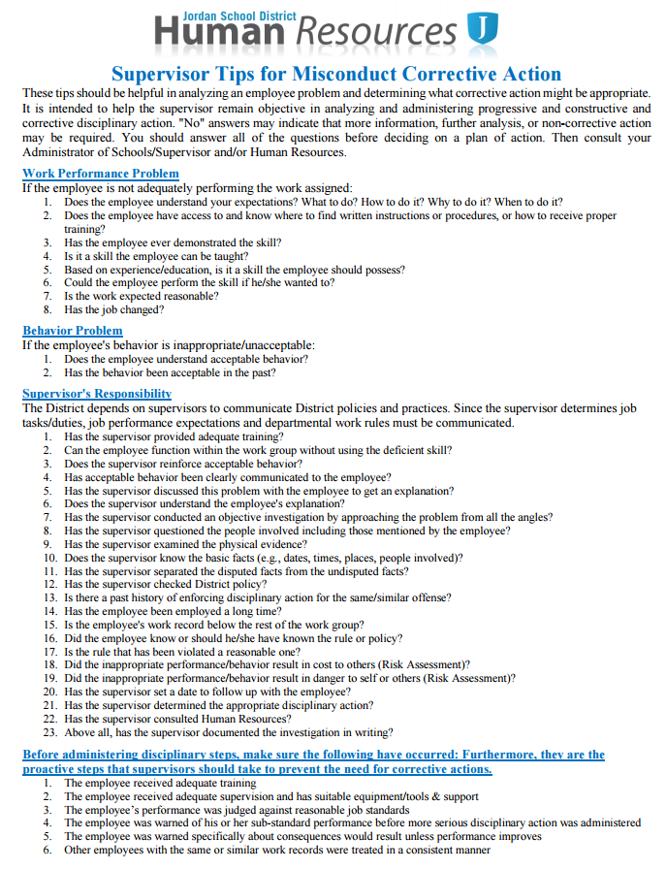
Employee Misconduct cont…
Supervisor Tips for Misconduct Corrective Action
Intended to help you ask questions to clarify the situation
Should help remove the “emotion” and consider the situation “cognitively”

Slide 21
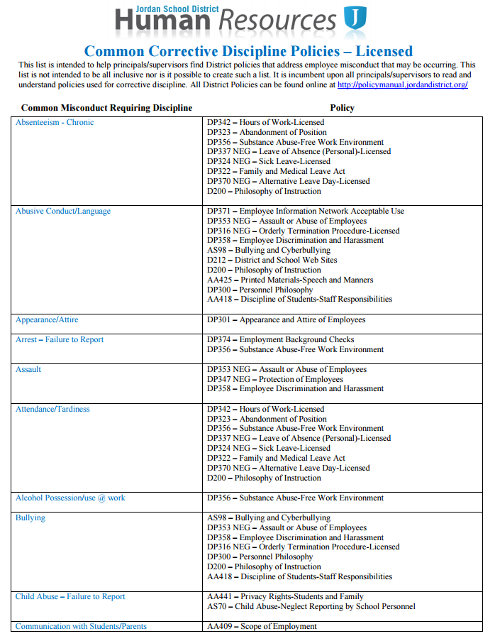
Employee Misconduct cont…
Common Corrective Discipline Policies – Licensed
Resource to match the misconduct with an existing District Policy

Slide 22
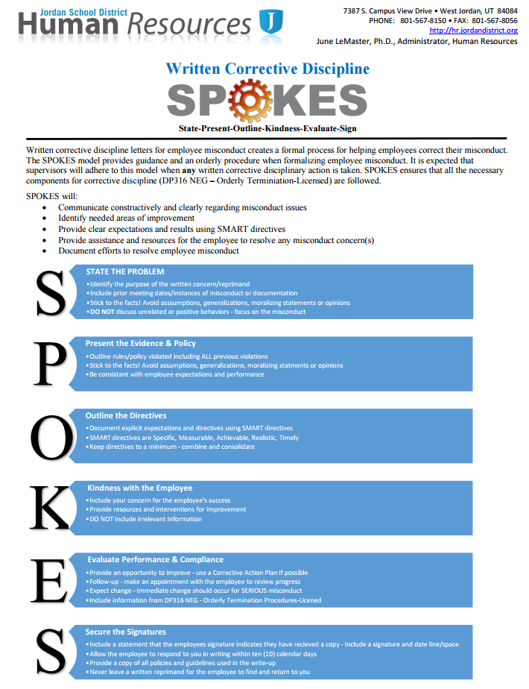
Employee Misconduct cont…
SPOKES
Use for EVERY written corrective discipline letter/memo
Ensures you include what is necessary
Ensures you DON’T include unnecessary things
S.M.A.R.T. Directives are KEY to moving to the next step

Slide 23
SMART Goals are:
Specific
Measurable
Attainable
Realistic
Timely
Using SMART goals will allow you and employee to know exactly what is expected, when to expect it completed, and if it was completed. NO GUESSING.

Slide 24
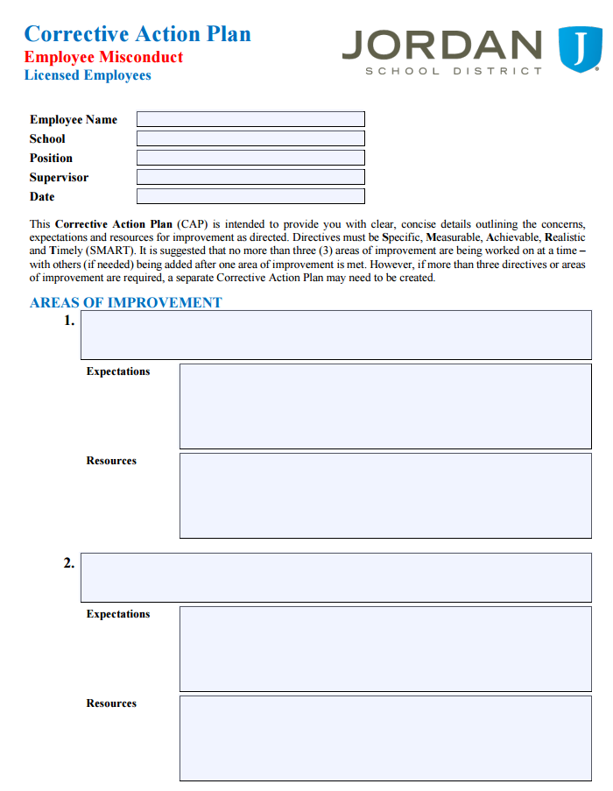
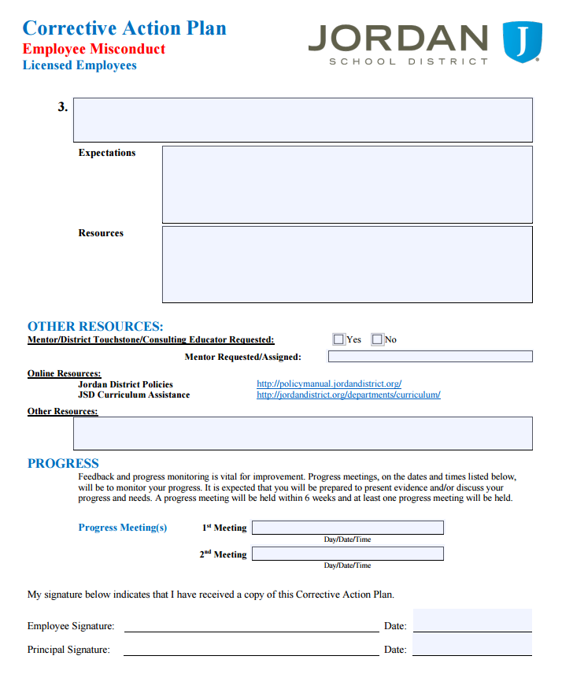
Employee Misconduct cont…
Corrective Action Plan
Corrective discipline is about improvement – extinguishing the misconduct
The Corrective Action Plan (CAP) is similar in design to the Plan for Improvement (JPAS addendum)
Documents assistance given.
Documents follow-up
Documents resources provided
Documents attempts to help the employee improve

Slide 25
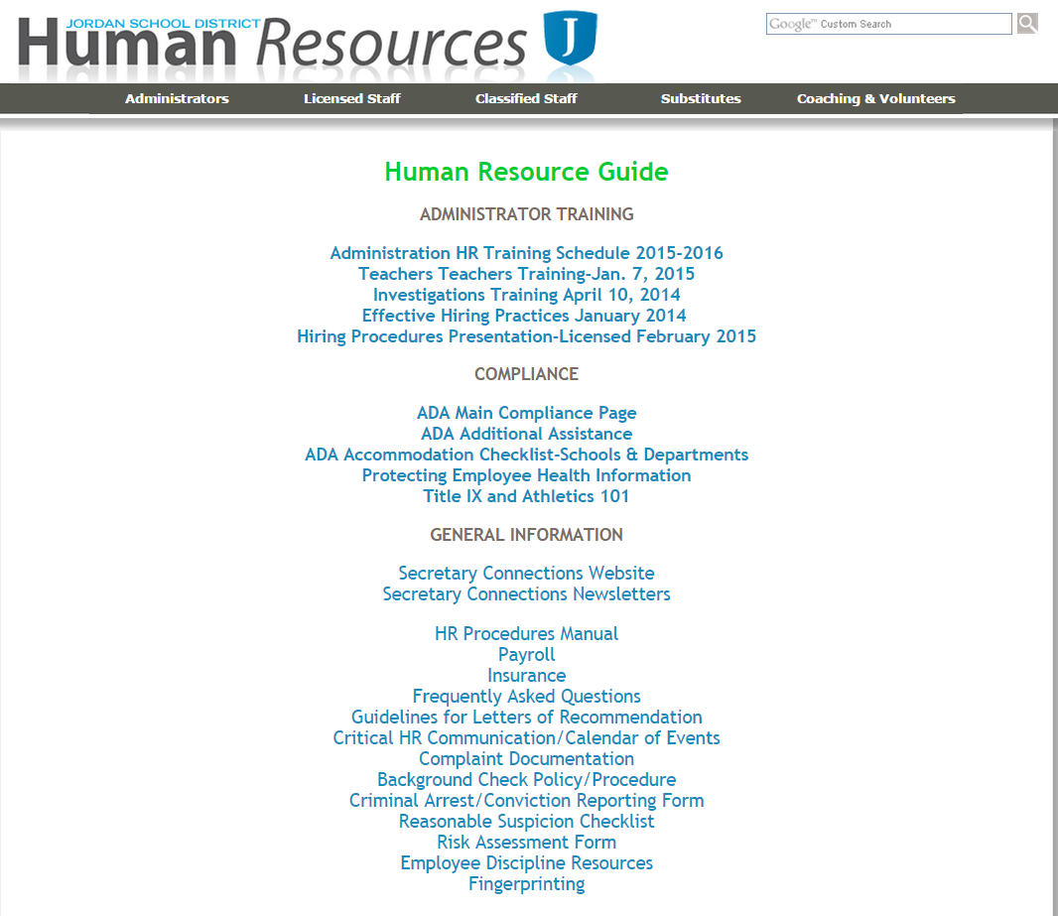
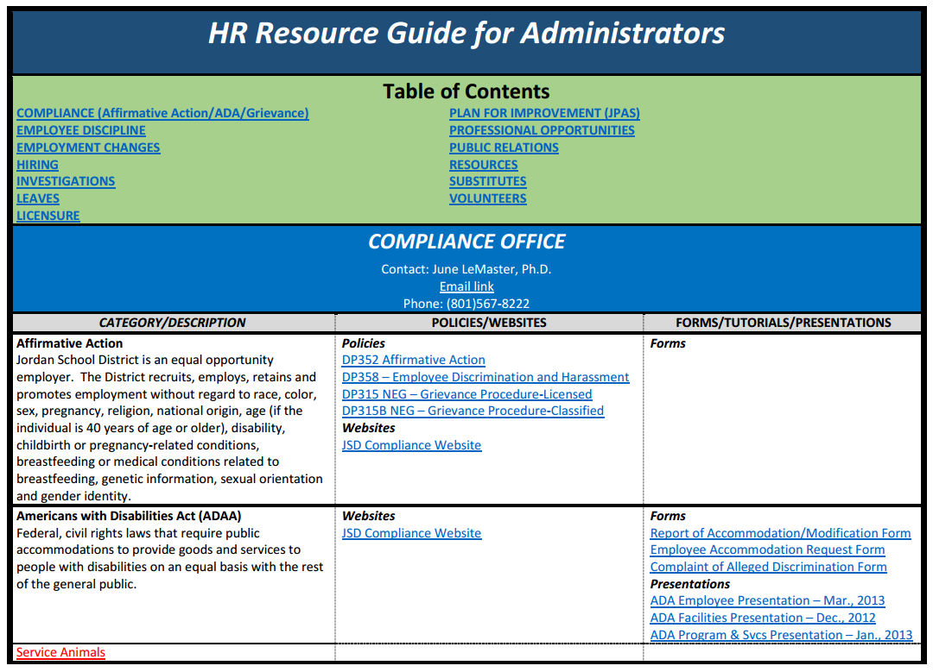
Employee Misconduct cont…
AdminOnly

Slide 26
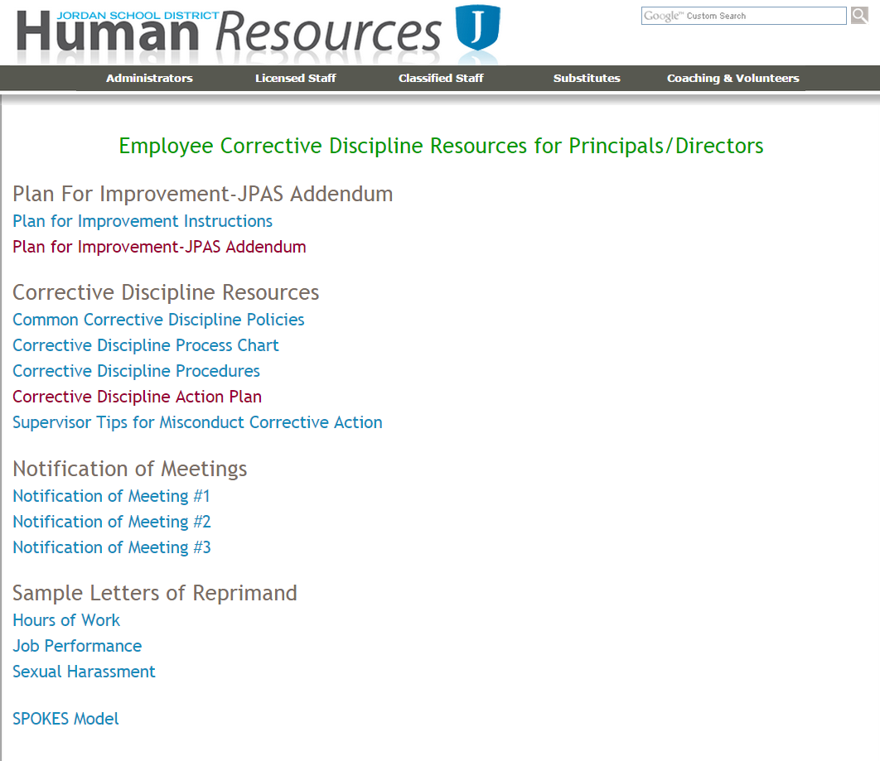
OR
AdminOnly

Slide 27
There is ALWAYS help
Human Resources
Upcoming Trainings:
June LeMaster
  Human Resource Administrator
Brent Burge
  Human Resource Administrator-Classified
Travis Hamblin
  Human Resource Administrator-Licensed
Optimizing HR Strategies for Effective “RIS, HIRES or TRANSFERS”
  January 7 8am or 2pm
NAVIGATING Teachers-Teachers.com (Bring your Laptop)
  February 18 8am, 10am, 1pm, 3pm
  Gretchen Bull-Switzer

